Slide 1
One VCU Academic Repositioning Task Force
Agenda
Opening Comments & Recap
Collective Recommendations
Grading: Constraints & Enabling Factors
New Groupings
Closing comments/Q&A
Operating Guidelines & Moving Forward
Organizational Structure - Schools & Department Overview
Internal Inertia - Past & Present
External Awareness
Workgroups & Approach
Next Steps

Slide 2
One VCU Academic Repositioning Task Force
Recap
Recap:
Gratitude & momentum
Provost’s vote of thanks
Internal & external factors
Hiatus & Pause
Preparation for Phase II
Retreat Considerations
Next Steps
Transparency & Collation
New groups

Slide 3
One VCU Academic Repositioning Task Force
Agenda
Opening Comments & Recap
Collective Recommendations
Grading: Constraints & Enabling Factors
New Groupings
Closing comments/Q&A
Operating Guidelines & Moving Forward
Organizational Structure - Schools & Department Overview
Internal Inertia - Past & Present
External Awareness
Workgroups & Approach
Next Steps

Slide 4
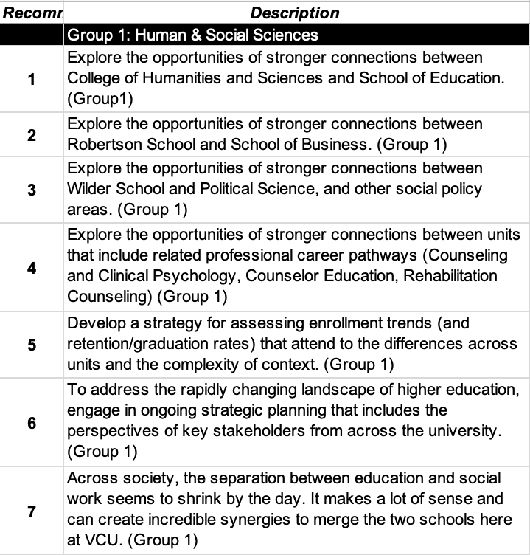
One VCU Academic Repositioning Task Force
Recommendations
RTF Cumulative Recommendations (Phase 1)
Total of 77 Recommendations based on initial internal & external assessment

Slide 5
One VCU Academic Repositioning Task Force
Agenda
Opening Comments & Recap
Collective Recommendations
Grading: Constraints & Enabling Factors
New Groupings
Closing comments/Q&A
Operating Guidelines & Moving Forward
Organizational Structure - Schools & Department Overview
Internal Inertia - Past & Present
External Awareness
Workgroups & Approach
Next Steps

Slide 6
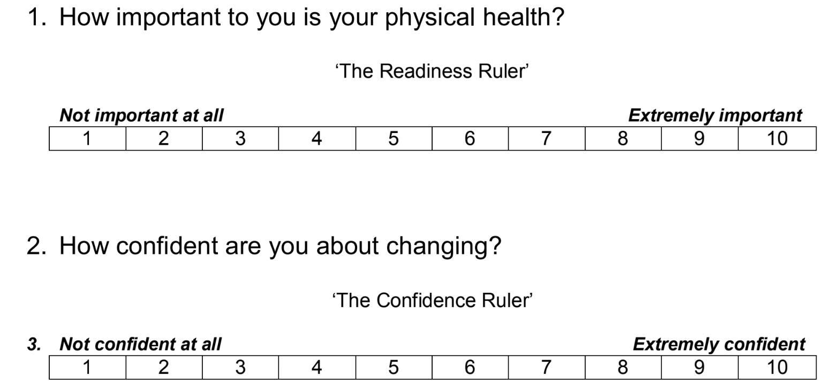
One VCU Academic Repositioning Task Force
Enabling & Constraining Factors
Conceptualize a “readiness ruler”

Slide 7
One VCU Academic Repositioning Task Force
Enabling & Constraining Factors
Contextualizing Recommendations

Slide 8
One VCU Academic Repositioning Task Force
Agenda
Opening Comments & Recap
Collective Recommendations
Grading: Constraints & Enabling Factors
New Groupings
Closing comments/Q&A
Operating Guidelines & Moving Forward
Organizational Structure - Schools & Department Overview
Internal Inertia - Past & Present
External Awareness
Workgroups & Approach
Next Steps

Slide 9
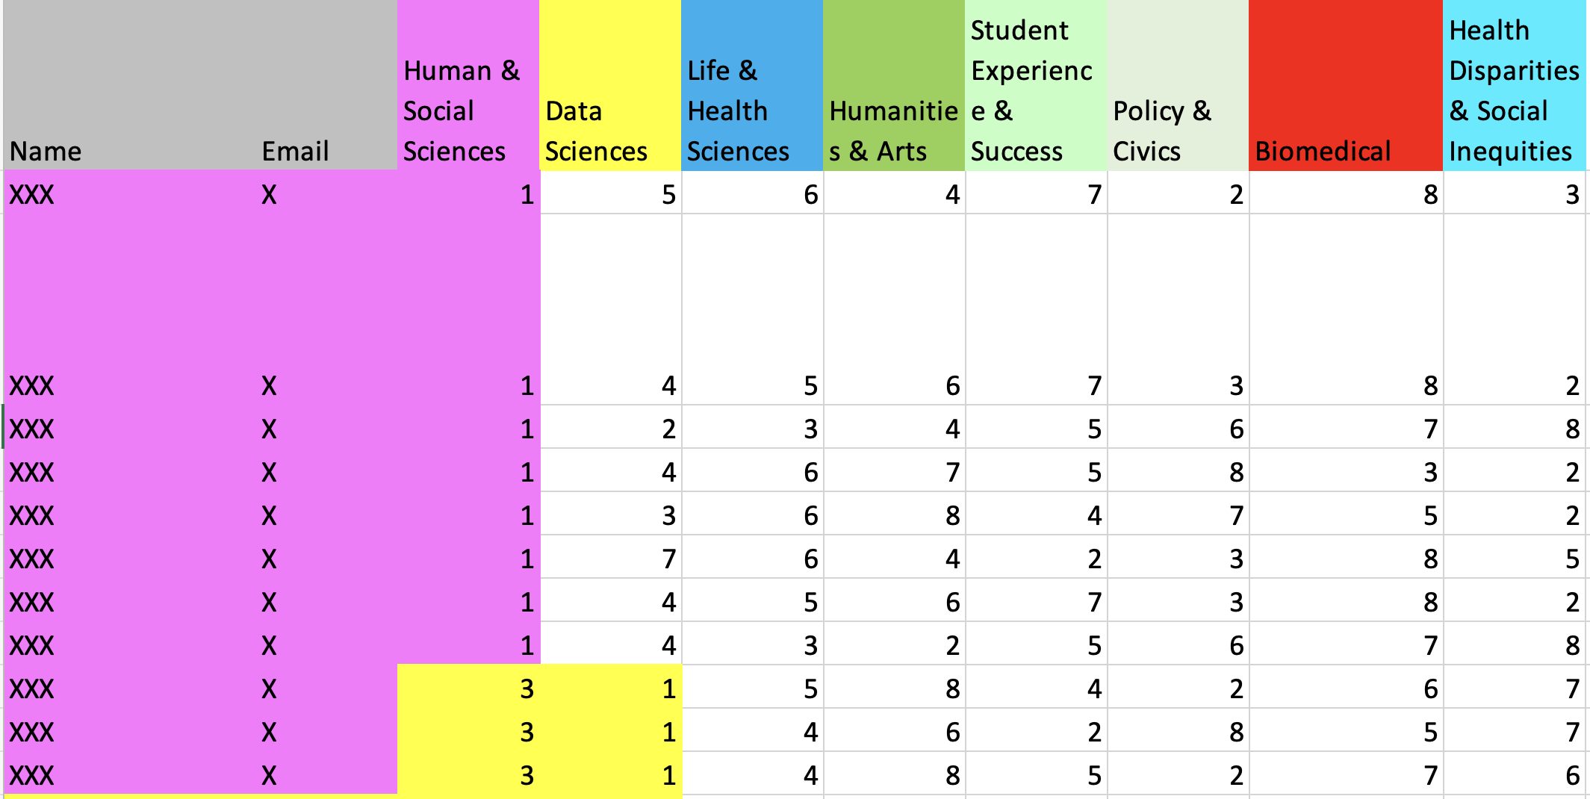
One VCU Academic Repositioning Task Force
Phase II
Phase II Workgroups

Slide 10
One VCU Academic Repositioning Task Force
Agenda
Opening Comments & Recap
Collective Recommendations
Grading: Constraints & Enabling Factors
New Groupings
Closing comments/Q&A
Operating Guidelines & Moving Forward
Organizational Structure - Schools & Department Overview
Internal Inertia - Past & Present
External Awareness
Workgroups & Approach
Next Steps

